Slide 1
Machine Learning AIML CZG565
M3 : Linear Models for Regression
Neha Vinayak
Course Faculty of MTech Cluster
BITS – CSIS - WILP

Slide 2

Machine Learning
Disclaimer and Acknowledgement
The content for these slides has been obtained from books and various other source on the Internet
We here by acknowledge all the contributors for their material and inputs.
We have provided source information wherever necessary
Students are requested to refer to the textbook w.r.t detailed content of the presentation deck shared over canvas
We have reduced the slides from canvas and modified the content flow to suit the requirements of the course and for ease of class presentation
Source: “Probabilistic Machine Learning, An Introduction”, Kevin P. Murphy, Slides of Prof.Sugata, Prof. Chetana from BITS Pilani, Prof. Raja vadhana from BITS Pilani , CS109 and CS229 stanford lecture notes and many others who made their course materials freely available online.

Slide 3
Course Plan
M1 | Introduction
M2 | Machine learning Workflow
M3 | Linear Models for Regression
M4 | Linear Models for Classification
M5 | Decision Tree
M6 | Instance Based Learning
M7 | Support Vector Machine
M8 | Bayesian Learning
M9 | Ensemble Learning
M10 | Unsupervised Learning
M11 | Machine Learning Model Evaluation/Comparison

Slide 4
Agenda
Linear Model for Regression
Direct solution vs Iterative Method
Gradient Descent
Linear Basis Function
Notion of Bias vs Variance
Notes:
Machine Learning, Tom Mitchell
Read Chapter 1, 2 – Introduction to Machine Learning, 2nd edition, Ethem Alpaydin

Slide 5
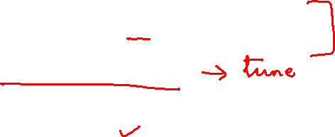
ML workflow
Should I use ML on this problem?
Is there a pattern to detect?
Can I solve it analytically?
Do I have data?
Gather and organize data.
Preprocessing, cleaning, visualizing.
Choosing a model, loss, regularization, ...
Optimization
Hyperparameter search
Analyze performance and mistakes, and iterate back to step 5 (or 3)

Slide 6
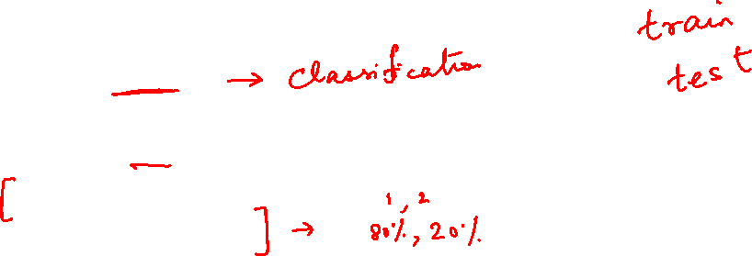
Inductive Learning Hypothesis
Any hypothesis found to approximate the target function well over a sufficiently large set of training examples will also approximate the target function well over other unobserved examples
Inductive learning or “Prediction”:
Given examples of a function (X, F(X))
Predict function F(X) for new examples X
Classification
F(X) = Discrete
Regression
F(X) = Continuous
Probability estimation
F(X) = Probability(X):

Slide 7
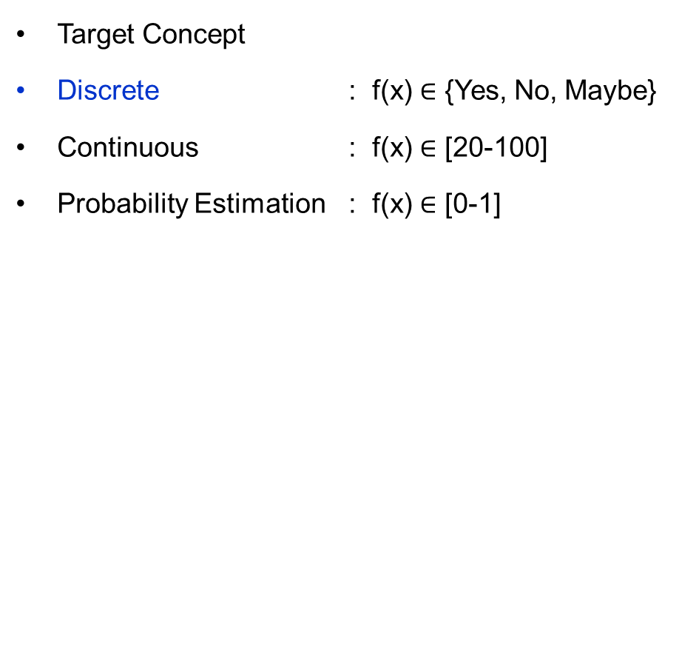
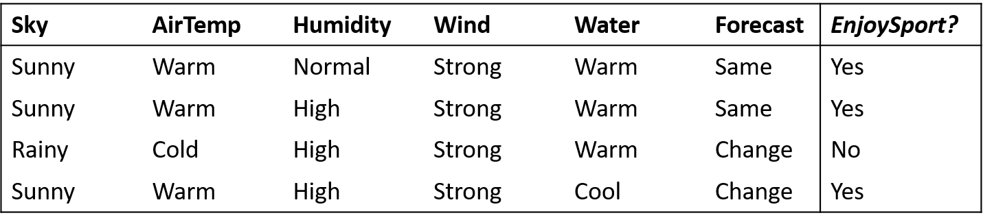
Inductive Learning Hypothesis
Classification
Regression

Slide 8
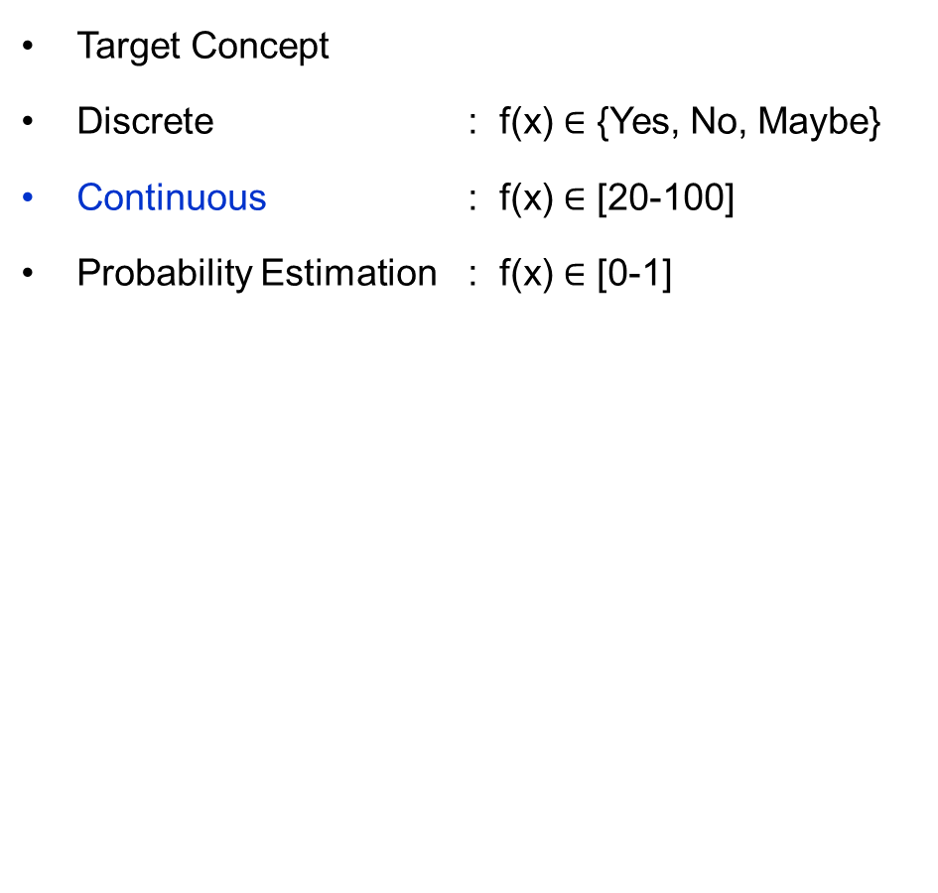
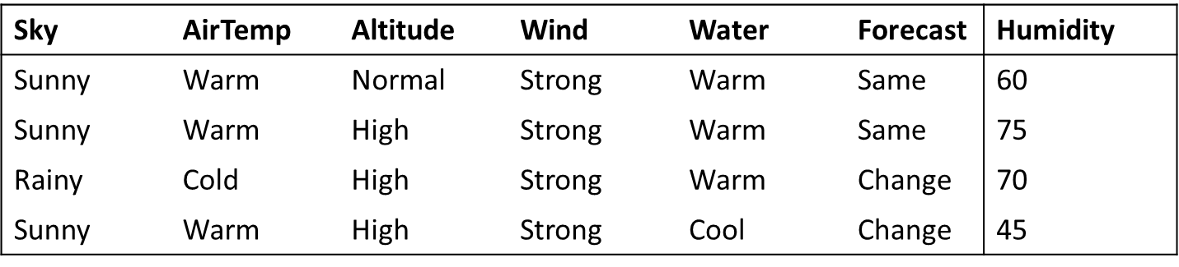
Inductive Learning Hypothesis
Classification
Regression

Slide 9
Linear Regression

Slide 10
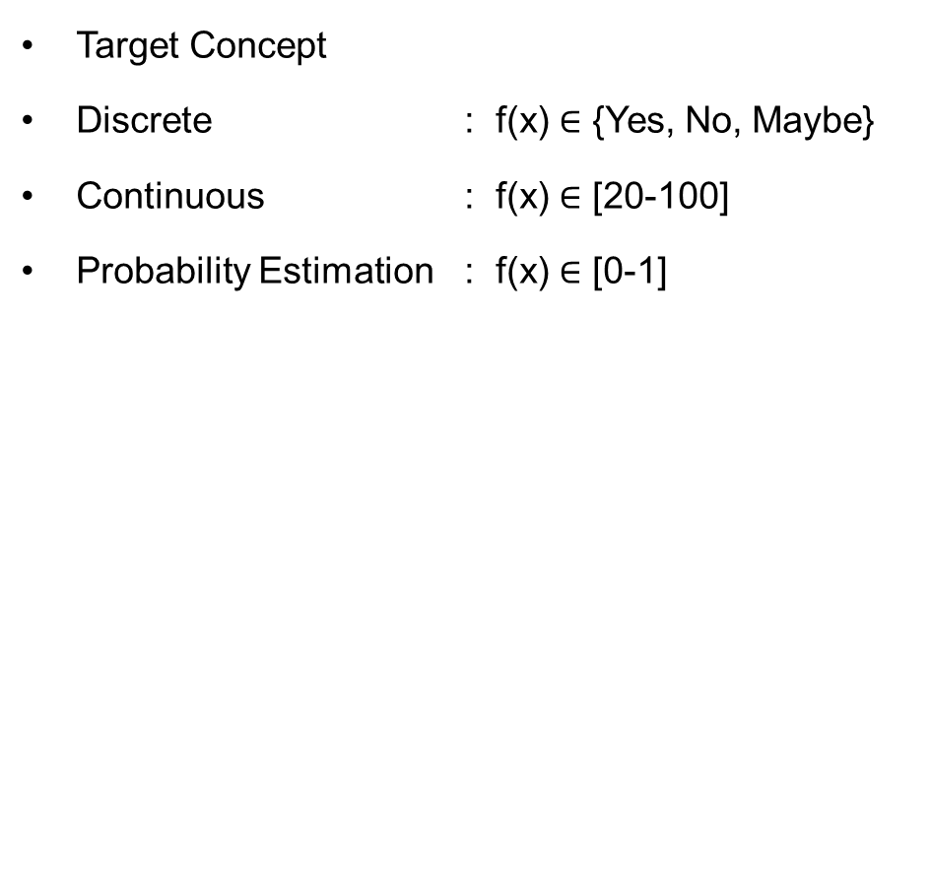
Inductive Learning Hypothesis : Interpretation
Classification
Regression

Slide 11


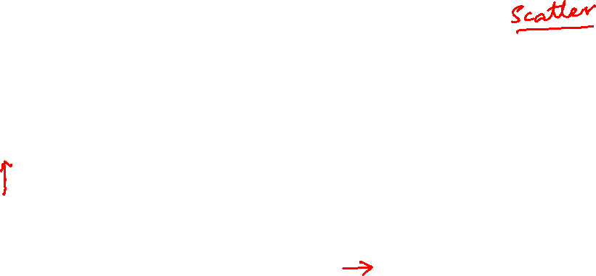
Formal Representation: Interpretation
Supervised Learning: Regression
GOAL : Previously unseen records should be assigned a value as accurately as possible.
Given (x₁, y₁), (x₂, y₂), ..., (x_{n}, y_{n})
Learn a function f (x) to predict y given x
– y is real-valued
9
8
7
6
5
4
3
2
1
0
1970 1980
September Arctic Sea Ice Extent (1,000,000 sq km)
1990
2000
2010
2020
Year Number

Slide 12

Formal Representation: Interpretation
Supervised Learning: Regression
GOAL : Previously unseen records should be assigned a value as accurately as possible.
Given (x₁, y₁), (x₂, y₂), ..., (x_{n}, y_{n})
Learn a function f (x) to predict y given x
– y is real-valued
9
8
7
6
5
4
3
2
1
0
1970 1980
September Arctic Sea Ice Extent (1,000,000 sq km)
1990
2000
2010
2020
Year Number

Slide 13
Formal Representation: Interpretation
Supervised Learning: Regression
GOAL : Previously unseen records should be assigned a value as accurately as possible.
Given (x₁, y₁), (x₂, y₂), ..., (x_{n}, y_{n})
Learn a function f (x) to predict y given x
– y is real-valued
9
8
7
6
5
4
3
2
1
0
1970 1980
September Arctic Sea Ice Extent (1,000,000 sq km)
1990
2000
2010
2020
Year Number

Slide 14
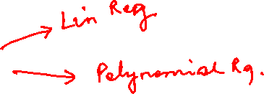
Formal Representation: Interpretation
Supervised Learning: Regression
GOAL : Previously unseen records should be assigned a value as accurately as possible.
Given (x₁, y₁), (x₂, y₂), ..., (x_{n}, y_{n})
Learn a function f (x) to predict y given x
– y is real-valued
9
8
7
6
5
4
3
2
1
0
1970 1980
September Arctic Sea Ice Extent (1,000,000 sq km)
1990
2000
2010
2020
Year Number

Slide 15
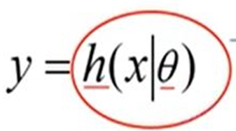

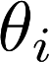
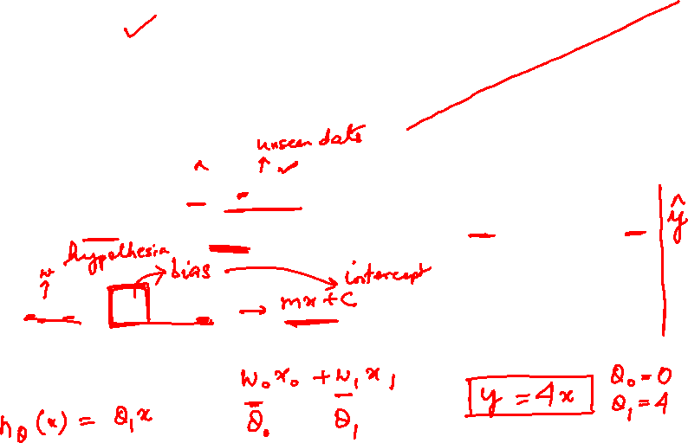
Machine Learning Process : Interpretation
Training Set
Price
(in 1000s of dollars)
Learning Algorithm
Size (feet²)
Size in feet² (x) | Price ($) in 1000's (y)
2104 | 460
1416 | 232
1534 | 315
852 | 178
… | …
Size of house
h
Estimated price
Hypothesis:
‘s : Parameters
h(.) : Model
How to choose ‘s ?

Slide 16
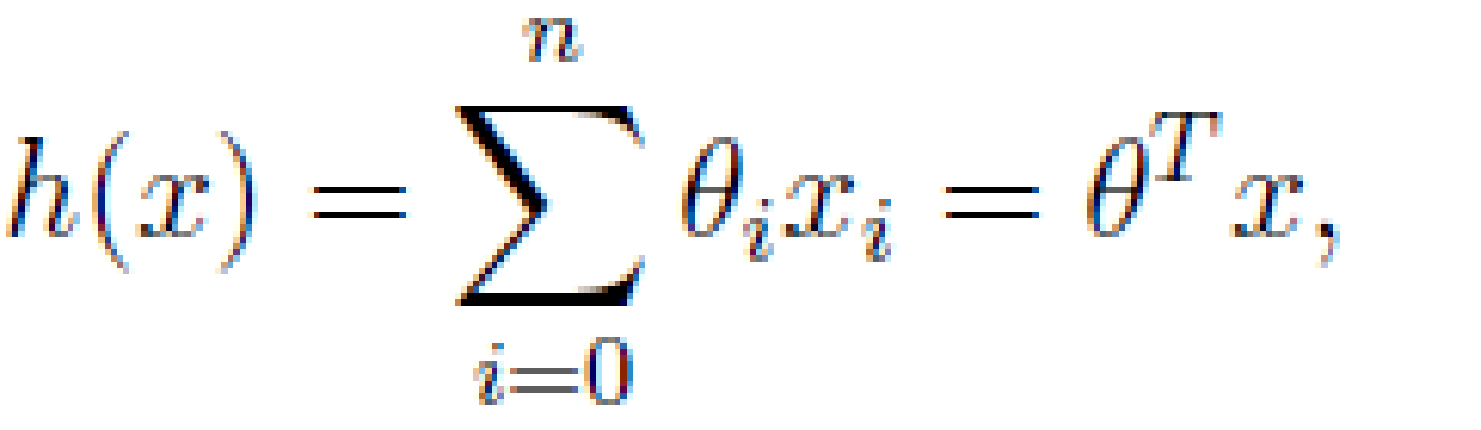
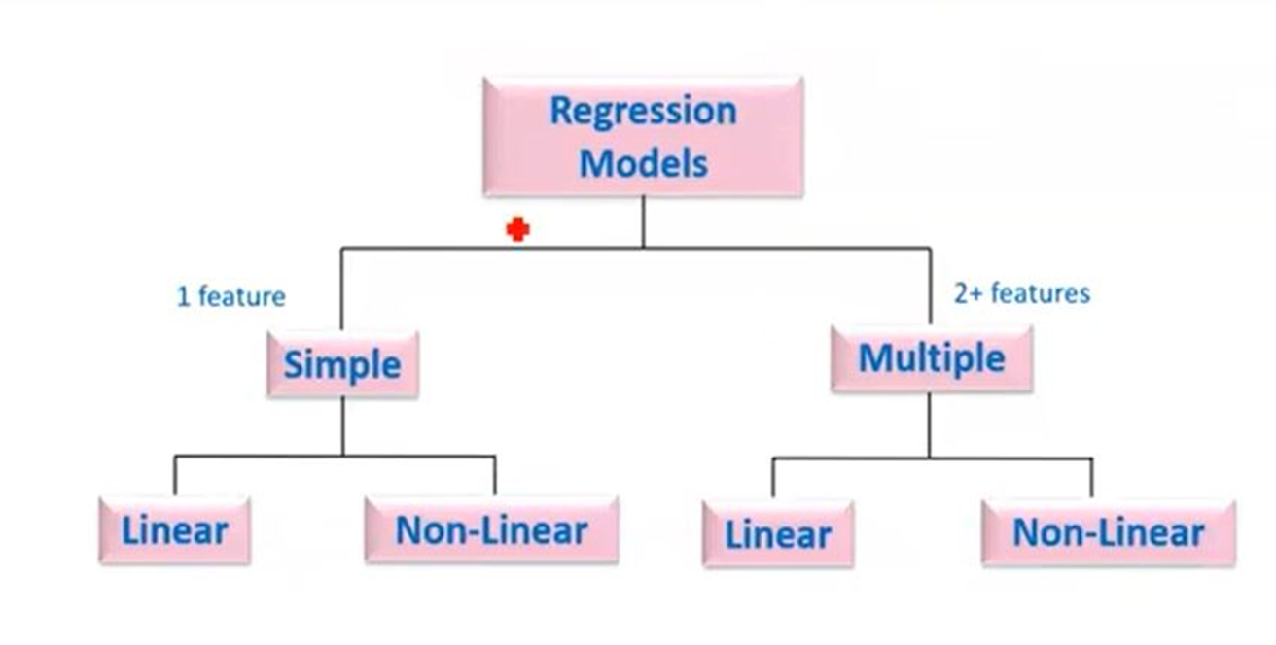
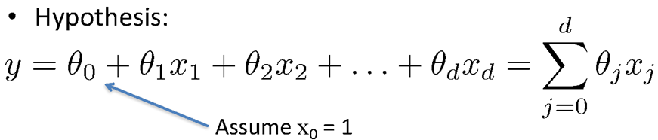
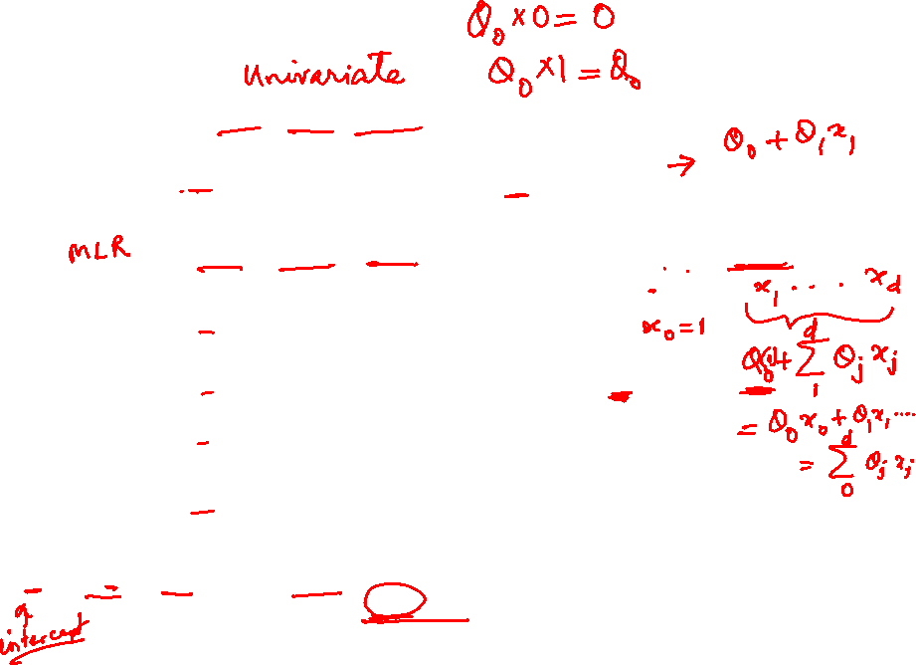
Types of Regression Models
Simple Linear regression model
(Education) x y (Income)
(Education) x₁
(Soft Skills) x₂
(Experience) x₃
(Age) x₄
Multiple Linear regression model
y (Income)

Slide 17

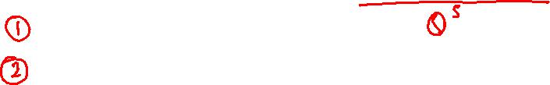
Learning the Model Parameters
Closed Form Solution Approach
Gradient Descent Approach

Slide 18
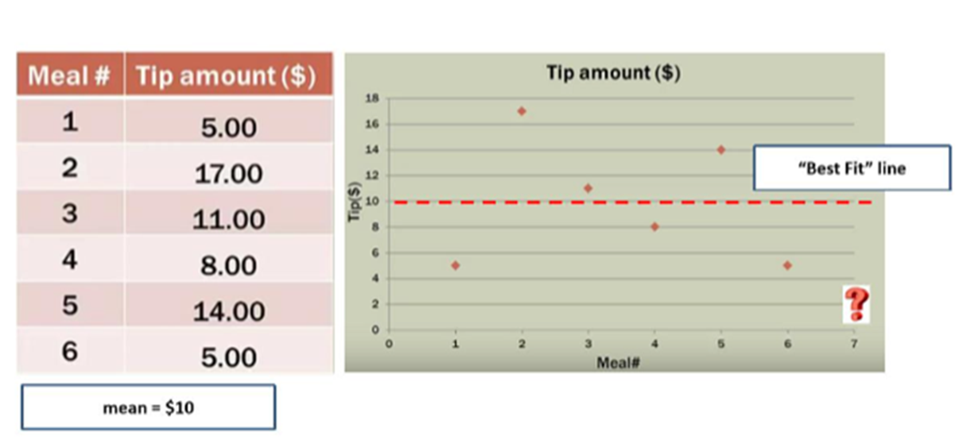
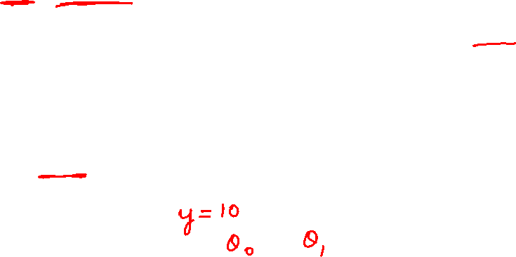
Notion of Cost Function
y = ɵ₀
y = ɵ₀

Slide 19
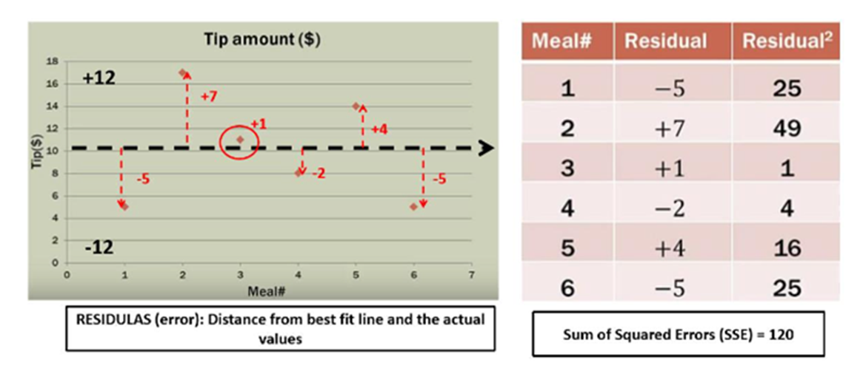
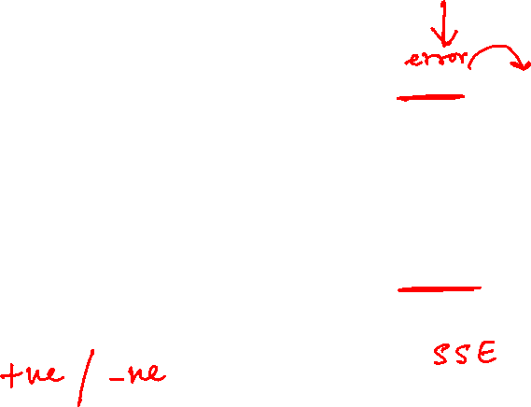
Notion of Cost Function

Slide 20
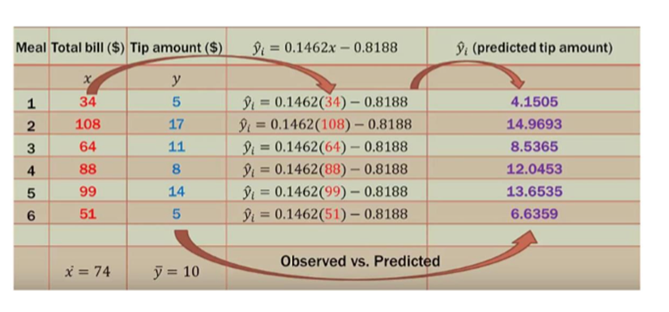
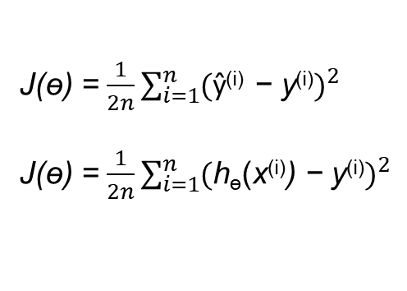
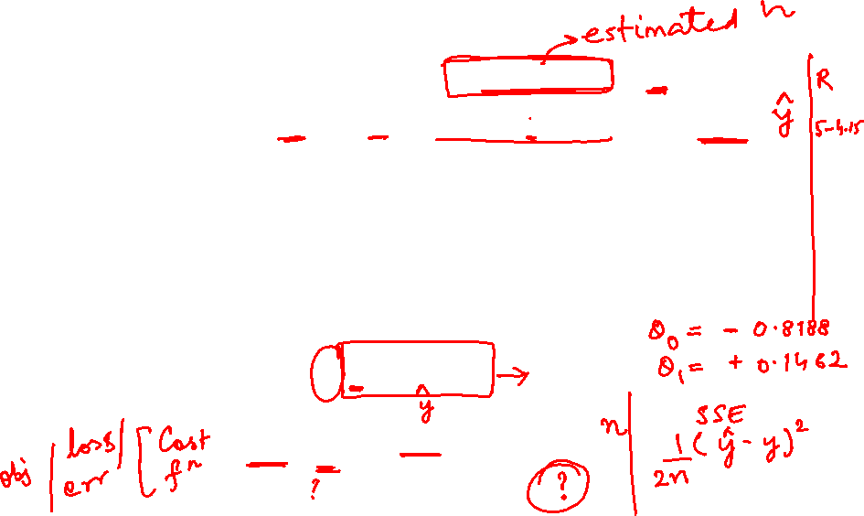
Notion of Cost Function
y = ɵ₀ + ɵ₁ x

Slide 21
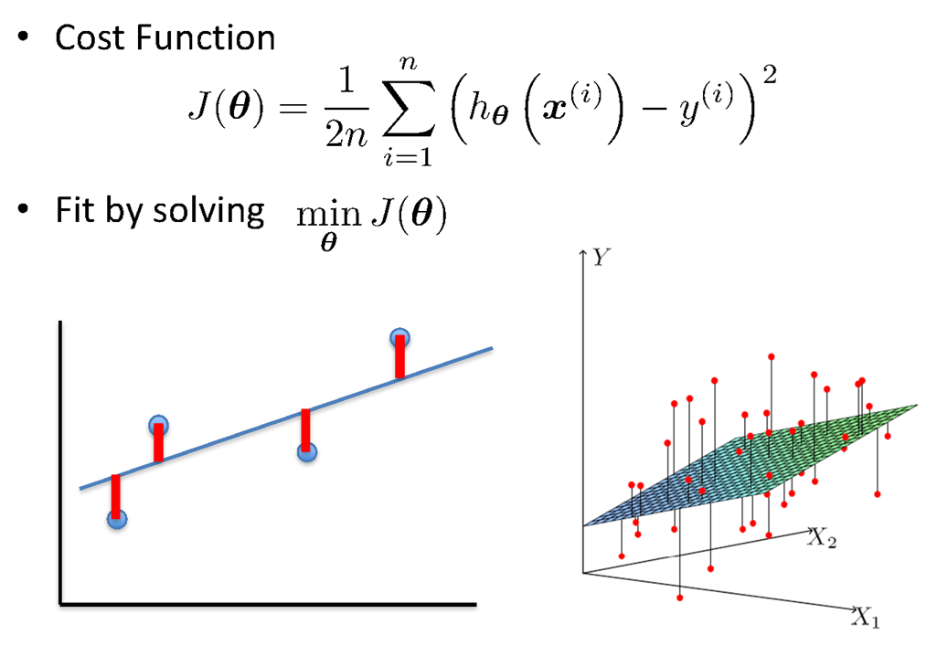
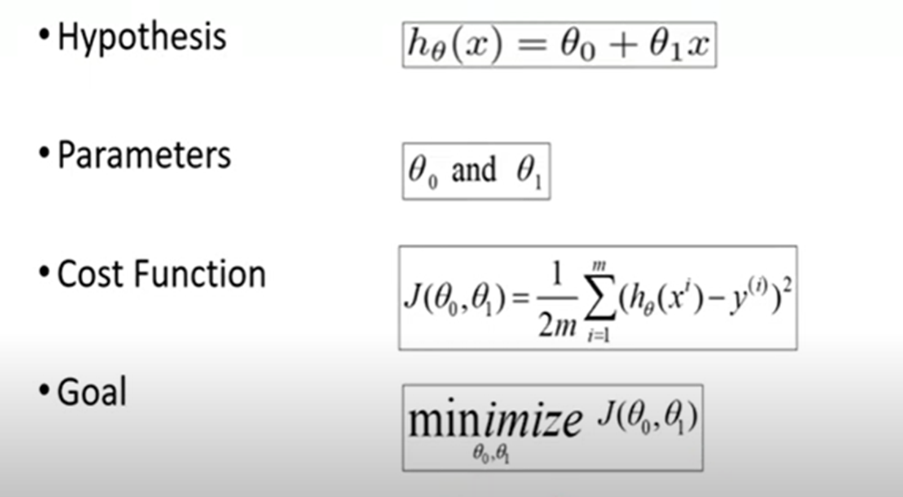
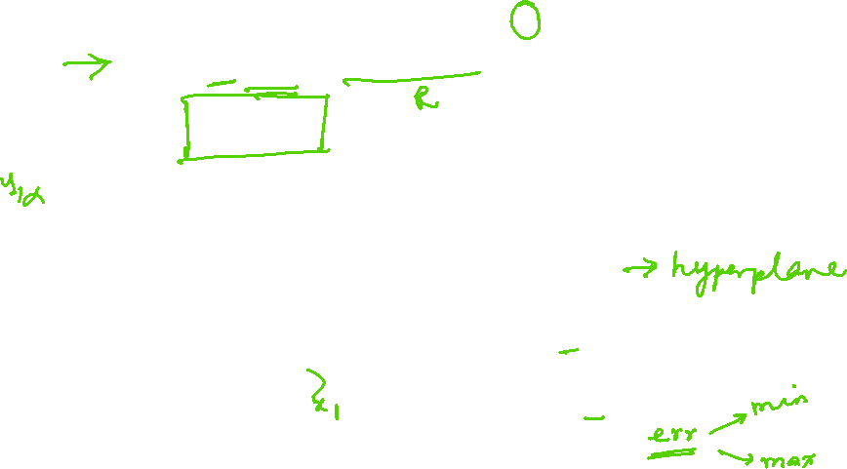
Linear Regression : Least Squares

Slide 22
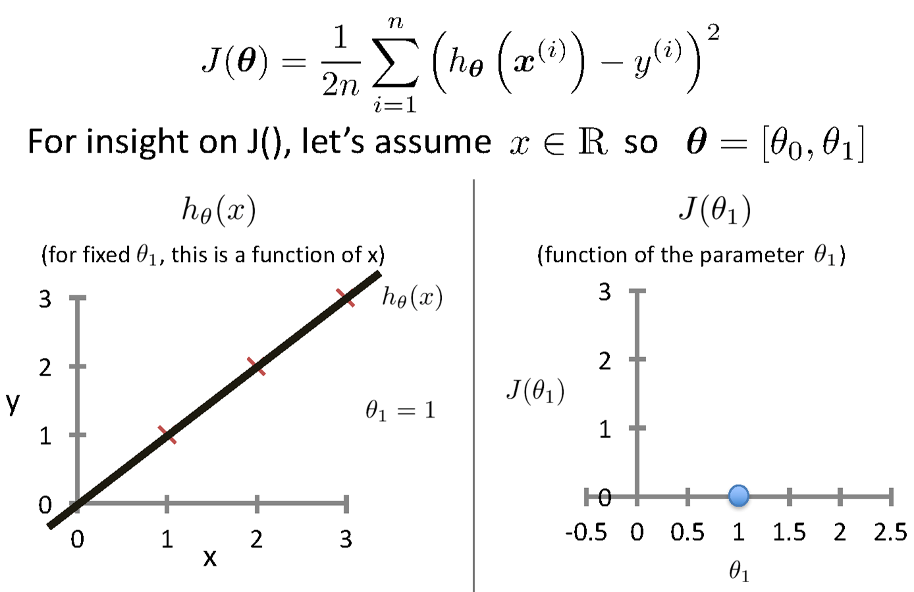
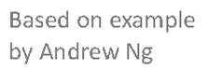
Intuition Behind Cost Function
Source Credit :

Slide 23
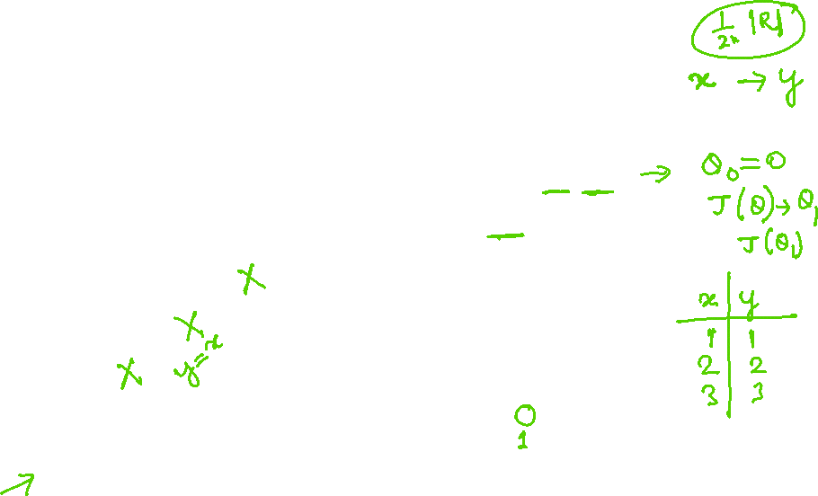
Intuition Behind Cost Function
Source Credit :

Slide 24
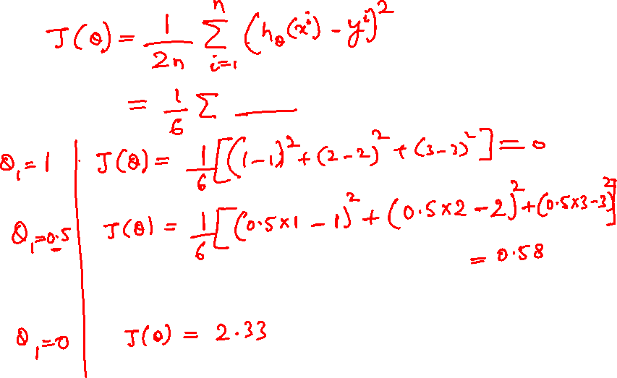

Slide 25
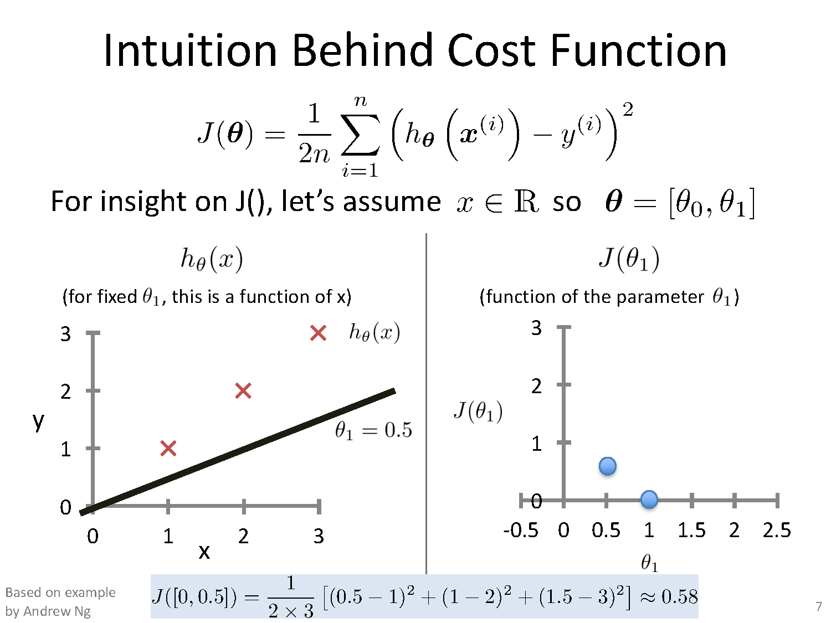
Intuition Behind Cost Function

Slide 26
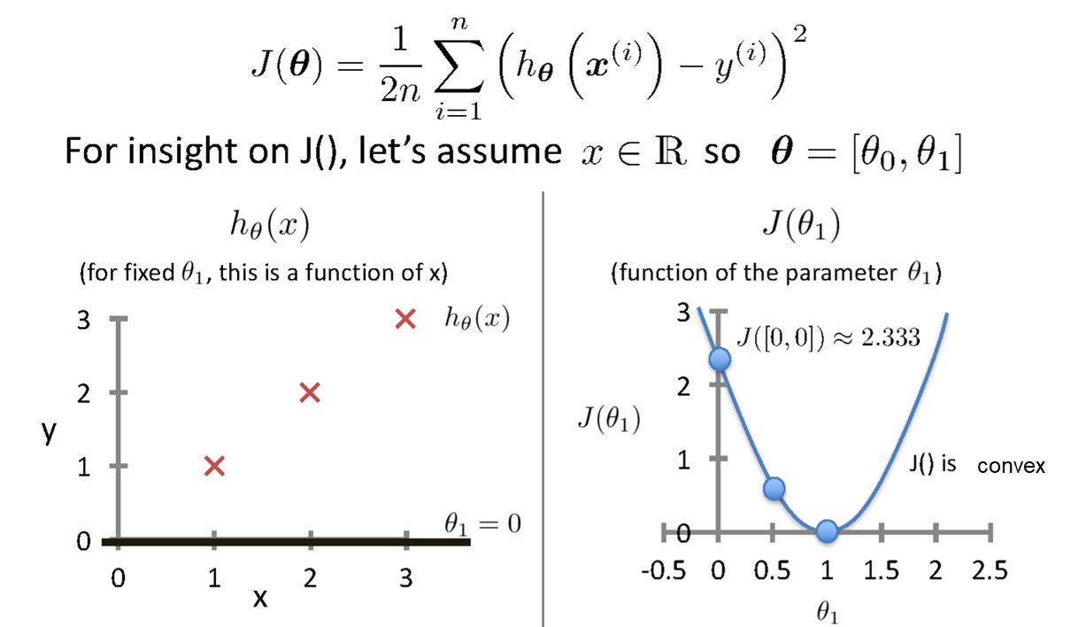
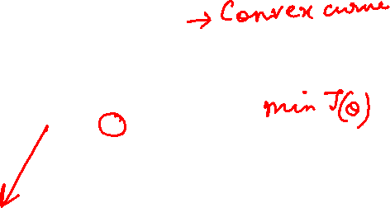
Intuition Behind Cost Function
Source Credit :

Slide 27
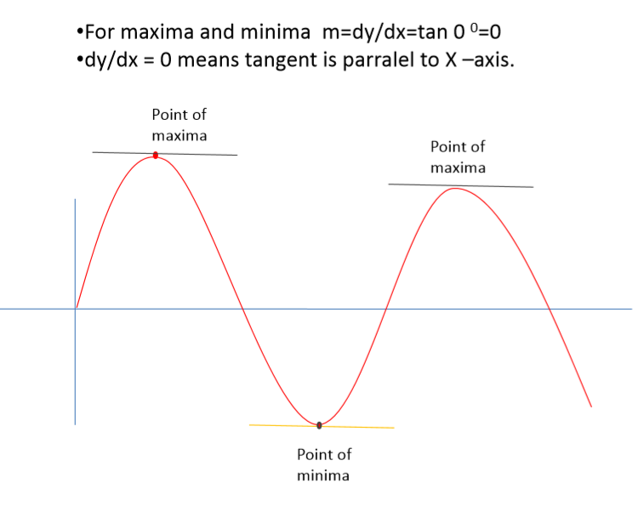
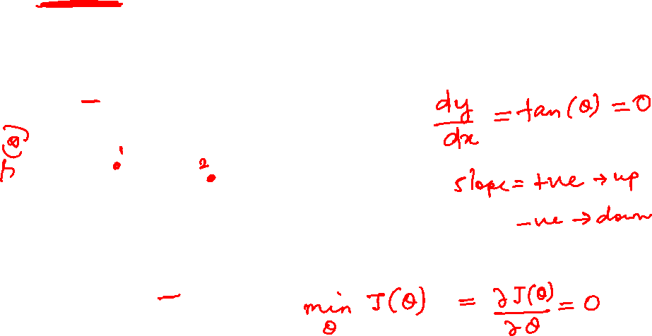
Notion of Maxima and Minima of a function
In General

Slide 28
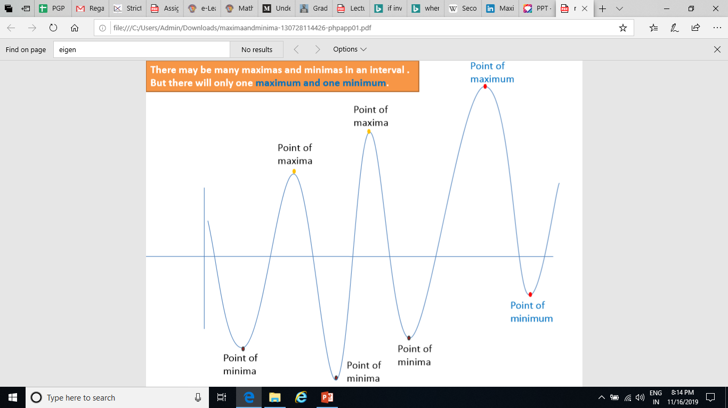
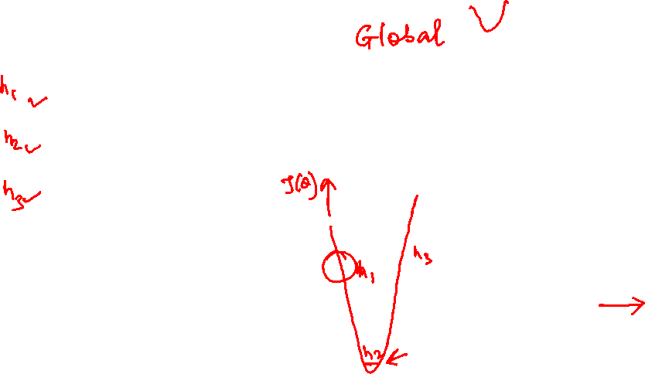
Notion of Maxima and Minima of a function
In Machine Learning
CarPrice = 1 + 0.05Mileage
CarPrice = 1 + 0.25Mileage
CarPrice = 1 + 0.75Mileage
15.7
15.3
Weight of Mileage
Mileage (in kmpl) | Car Price (in cr)
9.8 | 10.48
9.12 | 1.75
9.5 | 6.95
10 | 2.51
12.4
Sum of absolute Error
/ Training Error

Slide 29
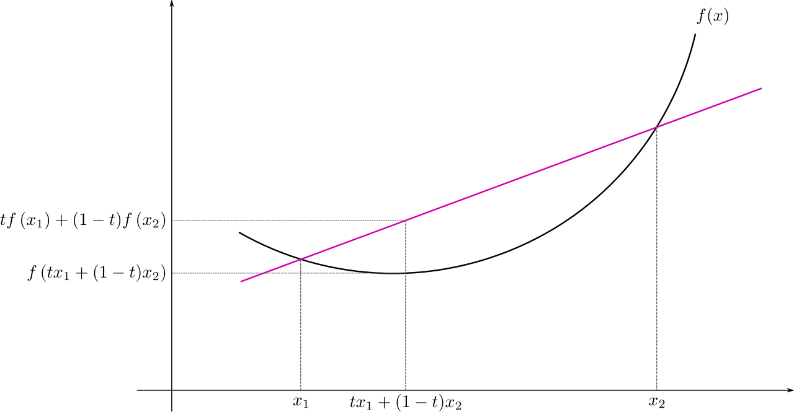
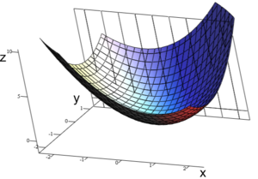
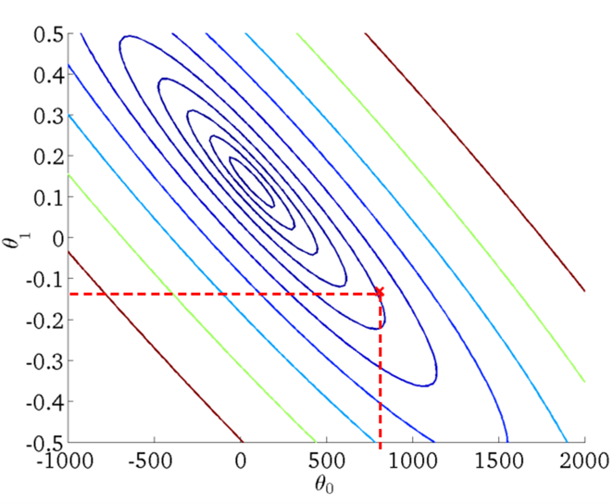
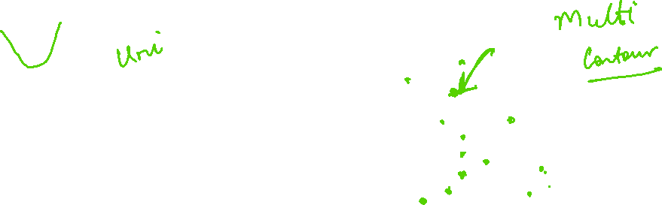
: Multivariate View
Convex Function
Real-valued function defined on an n-dimensional interval is called convex if the line segment between any two points on the graph of the function lies above or on the graph

Slide 30
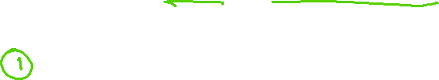
Learning Model Parameters Closed Form Solution

Slide 31
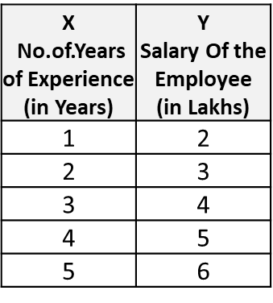
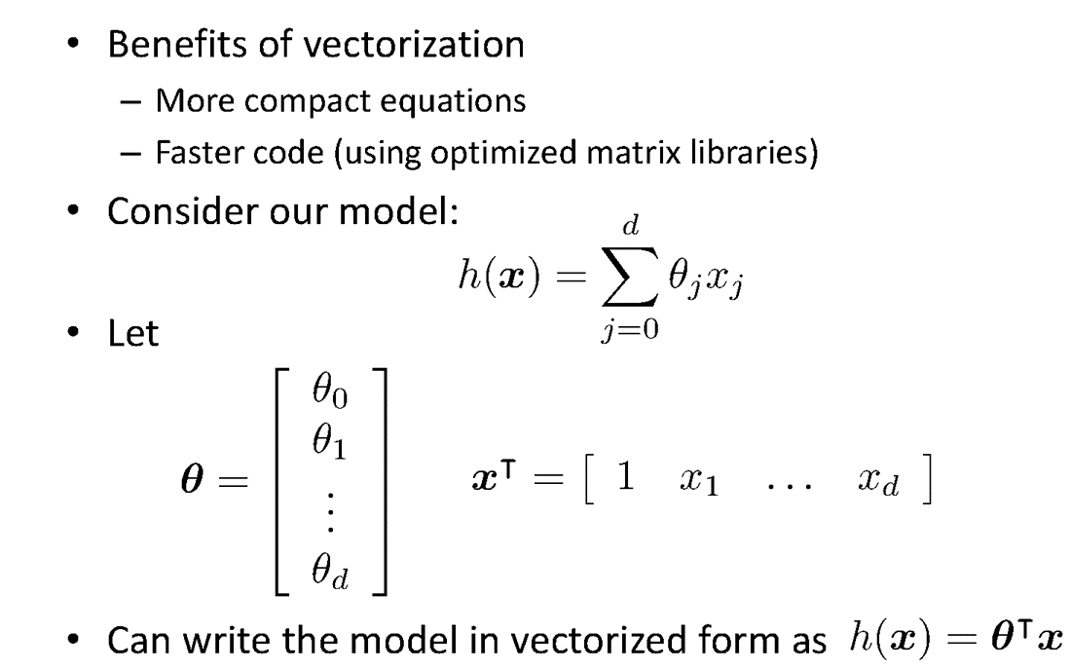
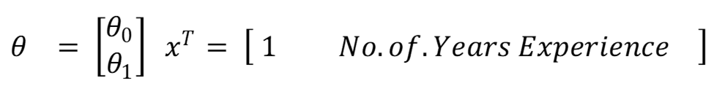
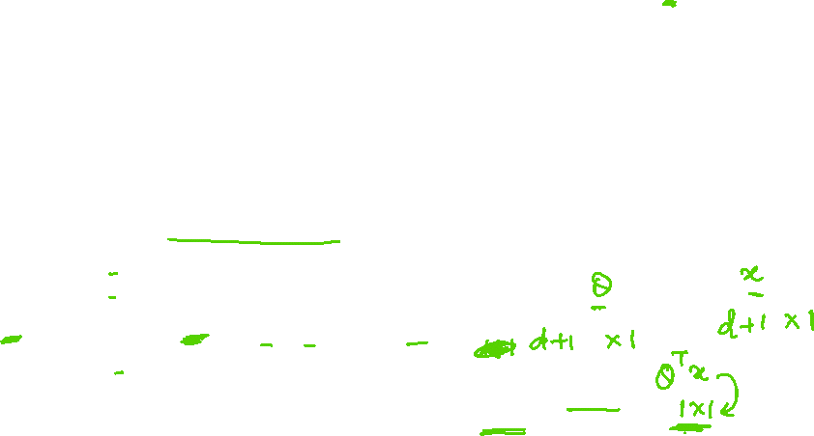
Vectorization

Slide 32
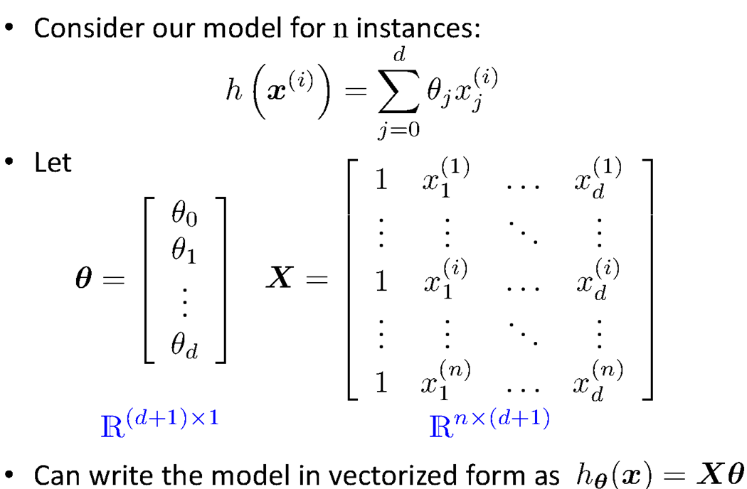
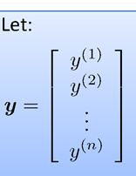
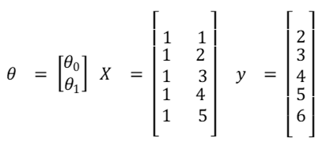

Vectorization

Slide 33



Vectorization

Slide 34


Vectorization

Slide 35


Vectorization

Slide 36





Fit the Linear Regression Model :
Using Closed Form – Problem Type 1

Slide 37
Learning Model Parameters Gradient Descent Approach

Slide 38


Intuition Behind Cost Function
Source Credit :

Slide 39


Intuition Behind Cost Function
Source Credit :

Slide 40


Basic Search Procedure
Source Credit : Figure by Andrew Ng

Slide 41


Basic Search Procedure
Source Credit : Figure by Andrew Ng

Slide 42

Basic Search Procedure
Source Credit : Figure by Andrew Ng

Slide 43


Size in feet² (x) | Price ($) in 1000's (y)
2104 | 460
1416 | 232
1534 | 315
852 | 178
… | …
Gradient Descent
Source Credit : Slide by Andrew Ng

Slide 44

Gradient Descent
Source Credit : Slide by Andrew Ng

Slide 45

Gradient Descent
Source Credit : Slide by Andrew Ng

Slide 46

Gradient Descent
Source Credit : Slide by Andrew Ng

Slide 47

Gradient Descent
Source Credit : Slide by Andrew Ng

Slide 48

Gradient Descent
Source Credit : Slide by Andrew Ng

Slide 49

Gradient Descent
Source Credit : Slide by Andrew Ng

Slide 50

Gradient Descent
Source Credit : Slide by Andrew Ng

Slide 51


Gradient Descent
Source Credit : Slide by Andrew Ng

Slide 52


Gradient Descent

Slide 53

Gradient Descent

Slide 54

Gradient Descent for Linear Regression

Slide 55






Guarantee of Convergence
Positive Derivative
𝞱₁
𝞱₁
𝞱₁
New 𝞱₁
Old 𝞱₁
Source Credit: Prof. Mohammad Hammoud

Slide 56



Guarantee of Convergence
Negative Derivative
𝞱₁
𝞱₁
𝞱₁
Old 𝞱₁
New 𝞱₁
Source Credit: Prof. Mohammad Hammoud

Slide 57

Choosing Learning Rate

Slide 58

Gradient Descent algorithm : Effect of Feature Scaling

Slide 59

Gradient Descent algorithm : Effect of Learning Rate :
Problem Type 2 – Interpretation of Convergence or Effect of Hyper parameters

Slide 60
Fit a linear Regression Line : Gradient Descent : Problem Type 3
Steps :
(Assuming : ‘n’ no.of.instances and two predictors {x1, x2} and linear regression)
Identification of the equations y = w0+w1X1+W2X2
Cost function & derivative
W0` = w0 – 1/n * learning rate * (sum (w0+w1X1+W2X2 - y))
W1` = w1 – 1/n * learning rate * (sum (w0+w1X1+W2X2 - y) * x1)
W2` = w2 – 1/n * learning rate * (sum (w0+w1X1+W2X2 - y)*x2)
Apply the equations

Slide 61

Fit a linear Regression Line : Gradient Descent
Fit a linear regression. Show only the first iteration of Gradient descent algorithm using learning rate of 0.02 for the following data , if the Relative Risk of Coronary Heart Disease is believed to be only linearly dependent on BMI as well as Diastolic Pressure. Assume the intercept of the regression model as 5 and the slope of independent variables as -0.03 (negative).
Steps :
Identification of the equations y = w0+w1X1+W2X2
Cost function & derivative
W0` = w0 – 1/3 * learning rate * (sum (w0+w1X1+W2X2 - y))
W1` = w1 – 1/3 * learning rate * (sum (w0+w1X1+W2X2 - y) * x1)
W2` = w2 – 1/3 * learning rate * (sum (w0+w1X1+W2X2 - y)*x2)
Apply the equations

Slide 62
Fit a linear Regression Line : Gradient Descent
Fit a linear regression. Show only the first iteration of Gradient descent algorithm using learning rate of 0.02 for the following data , if the Relative Risk of Coronary Heart Disease is believed to be only linearly dependent on BMI as well as Diastolic Pressure. Assume the intercept of the regression model as 5 and the slope of independent variables as -0.03 (negative).
Steps :
Identification of the equations: RR-CHD = 5 – 0.03 * BMI – 0.03 * DiastolicPressure
Cost function & derivative
W0` = w0 – 1/3 * 0.02 * (sum (5-0.03BMI-0.03DiastolicPresure - RRCHD))
= 5 – 1/3 * 0.02 * (sum (5-0.03BMI-0.03DiastolicPresure - RRCHD))
W1` = w1 – 1/3 * 0.02 * (sum (5-0.03BMI-0.03DiastolicPresure - RRCHD) * BMI)
= -0.03 – 1/3 * 0.02 * (sum (5-0.03BMI-0.03DiastolicPresure - RRCHD) * BMI)
W2` = w2 – 1/3 * 0.02 * (sum (5-0.03BMI-0.03DiastolicPresure - RRCHD) * DiastolicPresure)
= -0.03 – 1/3 * 0.02 * (sum (5-0.03BMI-0.03DiastolicPresure - RRCHD) * DiastolicPresure)
Apply the equations : Answer at the end of first iteration:
W0 = 5.0016 , W1 = 0.0476, w2= 0.179

Slide 63

Closed Form Solution Vs. Gradient Descent

Slide 64
Types of Gradient Descent Algorithms

Slide 65

Gradient Descent: Variants
Batch gradient descent refers to calculating the derivative from all training data before calculating an update.
Minibatch refers to calculating derivative of mini groups of training data before calculating an update.
Stochastic gradient descent refers to calculating the derivative from each training data instance and calculating the update immediately

Slide 66

Gradient Descent: Variants

Slide 67

Gradient Descent: Variants

Slide 68

Gradient Descent: Variants

Slide 69


Gradient Descent: Variants - Effect on Convergence

Slide 70
Evaluation Metrics

Slide 71




Evaluation of Linear Regression Model
Mileage (in kmpl) | Car Price (in cr)
9.8 | 10.48
9.12 | 1.75
9.5 | 6.95
10 | 2.51
…. | …..
Unseen Data
Mileage (in kmpl) | Car Price (in cr)
7.5 | 9.25
10 | 6.5
…. | …..
Model 1
CarPrice = 8.5 + 0.5 Mileage – 1.5 Mileage²
Model 2
CarPrice = -5.5 + 1.5 Mileage

Slide 72

Evaluation of Linear Regression Model R-squared
variation in ‘y’ that is explained by a regression model
Mileage (in kmpl) | Car Price (in cr)
9.8 | 10.48
9.12 | 1.75
9.5 | 6.95
10 | 2.51
…. | …..
Car Price (in cr)
10.48
1.75
6.95
2.51
Mean Y
variation in ‘y’ that is not captured/explained by a regression model
Model 1
CarPrice = 8.5 + 0.5 Mileage – 1.5 Mileage²
variation that is explained by a regression model
measures the goodness of fit of a regression model

Slide 73
Linear Basis Models
What if output is a non-linear function of input vector?

Slide 74




Polynomial Regression
17 / 22

Slide 75





Linear Basis Function Models

Slide 76



Linear Basis Function Models
Example: an M-th order polynomial function of one dimensional feature x :
where x^{j} = j-th power of x
Φ_{j}(x) are known as basis functions. Typically, Φ₀(x) = 1, so that w₀ acts as a bias.
In the simplest case, we use linear basis functions : Φ_{d}(x) = x_{d}.
They are called linear models because this function is linear in w.

Slide 77







Linear Basis Function Models - Examples

Slide 78
Notion of Bias - Variance

Slide 79

Quality of Fit

Slide 80

Handling Overfitting – Way 1
Increase in Size of the data set reduces the over-fitting problem

Slide 81


Effect of Training Size on Over fitting Problem Type 4 : Interpretation of the Model Fit
Size of training dataset needs to be large to prevent overfitting when higher order model is used.
Higher order model
Lower order model

Slide 82

Polynomial Fitting can lead to Overfitting
Handling Overfitting – Way 2 – Reduce the complexity of the model
Underlying target function is quadratic
Linear model results in under fitting with large bias
Polynomial of order 300 results in a large variance

Slide 83

How to experiment on Model Complexity ?

Slide 84

Handling Overfitting – Way 3
Early Stop the Training

Slide 85
Regularization (*This notion is common for both Linear Regression – Module 3 and Logistic Regression – Module 4)

Slide 86

Overfitting vs Underfitting
Overfitting
Underfitting
Fitting the data too well
Features are noisy / uncorrelated to concept
Learning too little of the true concept
Features don’t capture concept
Too much bias in model

Slide 87

Regularization

Slide 88

Regularization

Slide 89

Understanding Regularization

Slide 90

Understanding Regularization

Slide 91

Understanding Regularization

Slide 92


Regularization
Ridge Regression / Tikhonov regularization

Slide 93




Regularization
Lasso Regression (Least Absolute Shrinkage and Selection Operator Regression)

Slide 94



Regularization
Elastic Net
+ r
Control the regularization using the Mix Ration “r”:
When,
r = 0, Elastic Net is equivalent to Lasso Regression,
r = 1, it is equivalent to Ridge Regression
from sklearn.linear_model import ElasticNet
ElasticNet(alpha=0.1, l1_ratio=0.5)

Slide 95
How to choose the right Regularization?
Common Usage & Observation
L1 regularization has the ability to set some coefficients to 0 exactly leading to a sparse model
L1 regularization helps in feature selection by eliminating the features that are not important
L1 cannot be used efficiently in gradient-based approaches since it is not-differentiable unlike L2
L2 will in general lead to small magnitudes of weights but not exactly 0.
Elastic net – Prefer in Highly correlated features

Slide 96
Numerical Exercise – For Student Practice
Fit a linear regression. Show only the first iteration of Gradient descent algorithm using learning rate of 0.02 for the following data , if the Relative Risk of Coronary Heart Disease is believed to be only linearly dependent on BMI as well as Diastolic Pressure. Assume the intercept of the regression model as 5 and the slope of independent variables as -0.03 (negative).
Apply a regularization on the same problem with regularization constant 5 and apply GD for 2 iterations & interpret the results. Try both ridge regression as well as lasso regression. Below equation is changed only for ridge regression. Students must apply appropriate GD update equation changes for this problem.
Steps :
Identification of the equations y = w0+w1X1+W2X2
Cost function & derivative
W0` = w0 – 1/3 * learning rate * (sum (w0+w1X1+W2X2 - y))
W1` = w1* (1- learning rate * regularization constant) – 1/3 * learning rate * (sum (w0+w1X1+W2X2 - y) * x1)
W2` = w2 * (1- learning rate * regularization constant) – 1/3 * learning rate * (sum (w0+w1X1+W2X2 - y)*x2)
Apply the equations

Slide 97
Python Lab Exercise – For Student Practice
Go to your virtual lab file under : Machine Learning 🡪 LabCapsule 2 Linear _ Polynomial Regression 🡪 3 Polynomial Regression
Download ML_Lab 5 PolynomialRegression.ipynb
Try to change the degree to {2, 5, 7, 10} in the below function line :
PolynomialFeatures(degree=3)
Observe and interpret on the performance of the training data
Note: Training vs Test Data split is not coded in this implementation. Below are the suggestions to experiment further:
Add few hundreds of data (Use synthetic data generation python libraries available : Refer here )
Split the data into 80% train vs 20% test set
Built the polynomial model using above four different degree on training set
For each of the model apply in the test set
Find the MSE for both training data and separately for test data
Plot the four experiment results in a plot and interpret the notion of overfit vs underfit
Suggest which degree is a best fit .

Slide 98


Slide 99
Thank you !

